Slide 1
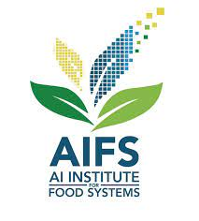

AIBridge
Summary

Slide 2
Recap
Q: What different types of ML did we talk about?
Notes:
Unsupervised learning methods are used in bioinformatics for sequence analysis and genetic clustering; in data mining for sequence and pattern mining; in medical imaging for image segmentation; and in computer vision for object recognition.

Slide 3
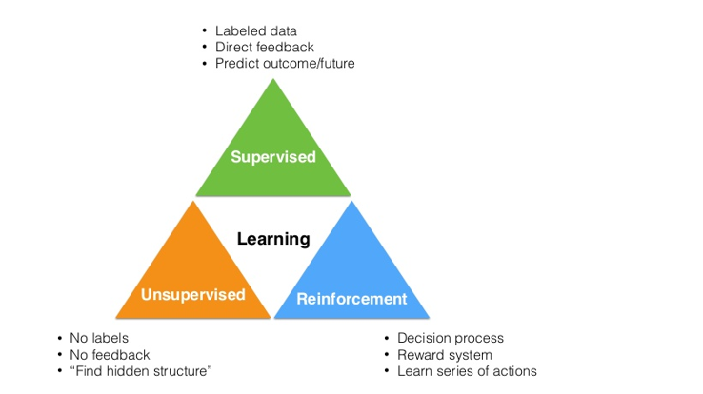
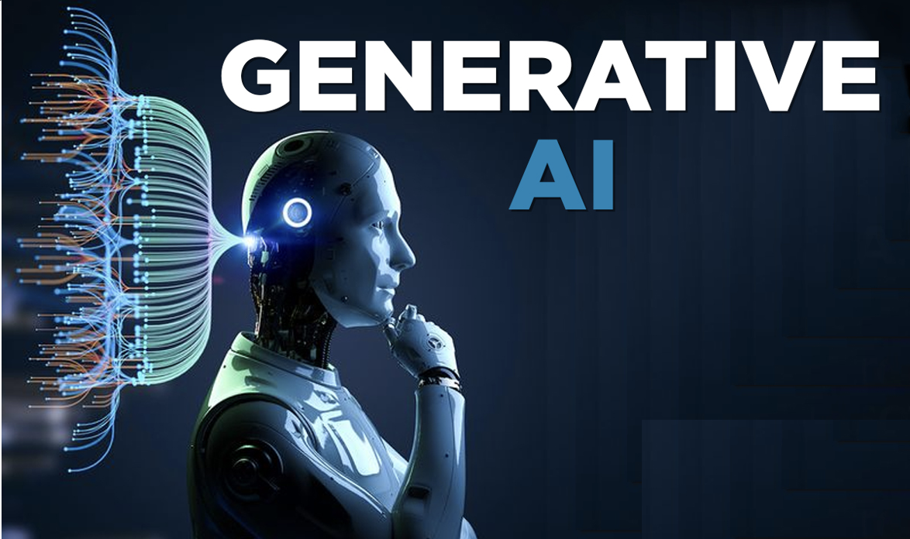
Recap
Algorithms
Data
Feature
Metrics
AI ops
Algorithms:
Linear regression
Logistic regression
Decision tree, random forest
Naïve Bayes
KNN
Algorithms:
Clustering
PCA
Notes:
Unsupervised learning methods are used in bioinformatics for sequence analysis and genetic clustering; in data mining for sequence and pattern mining; in medical imaging for image segmentation; and in computer vision for object recognition.

Slide 4
Additional Resources
StatQuest with Josh Starmer
Coursera, Andrew Ng, DeepLearning.AI
YouTube, Hung-yi Lee , NTU
Reinforcement learning, David Silver, DeepMind
And many more
Notes:
Unsupervised learning methods are used in bioinformatics for sequence analysis and genetic clustering; in data mining for sequence and pattern mining; in medical imaging for image segmentation; and in computer vision for object recognition.

Slide 5
Today’s AI is already extremely versatile.

Slide 6
Today’s AI is already extremely versatile. But where are we headed in the future?

Slide 7
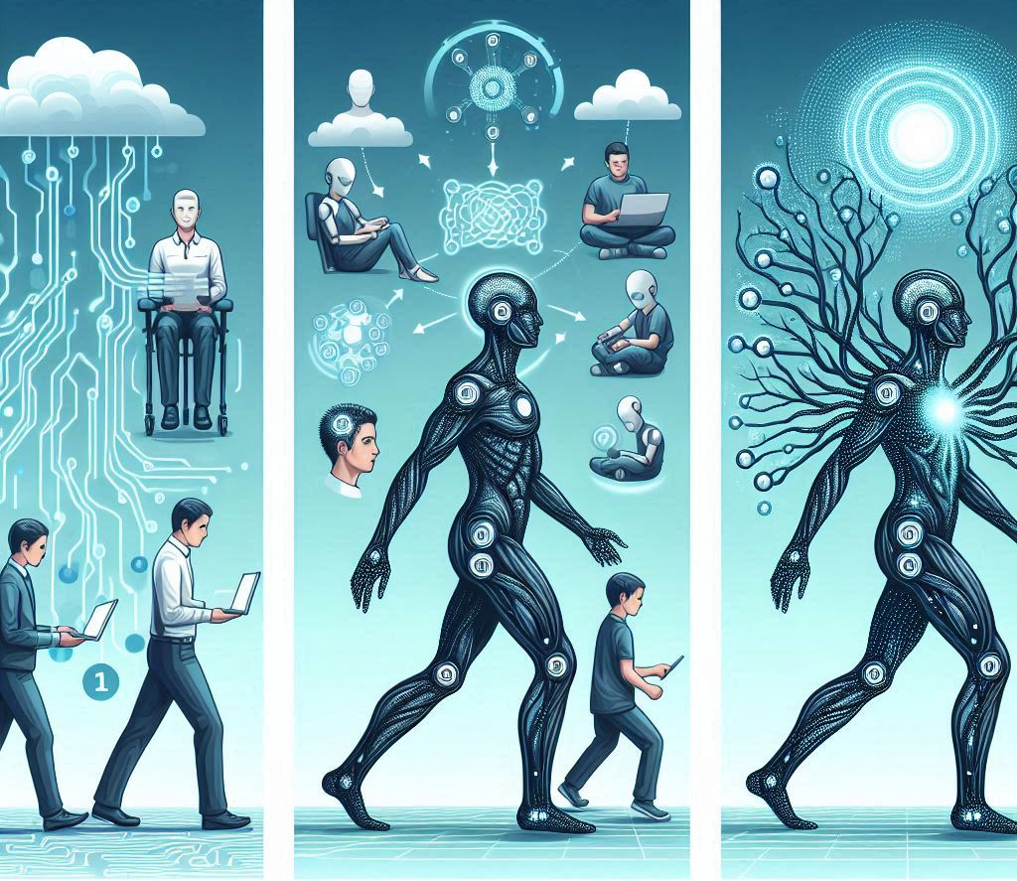
Catalyst, collaborator, consummation

Slide 8
The short-term goal: catalyzing productivity

Slide 9
Catalyst
Aiding human productivity
“Weak” AI: humans need to be in the loop
Notes:
Right now, AI cannot truly “think” with humans, and instead are more focused on menial retrieval and structural generation tasks, as we’ll see later on in this lecture.
Explanation of present-day AI as "weak" AI, requiring human-in-the-loop feedback, prompt engineering, and other interventions.

Slide 10
The medium-term goal: AI that can collaborate with us and do its own tasks

Slide 11
The long-term goal: Artificial General Intelligence (AGI)
Artificial general intelligence (AGI) is a type of artificial intelligence (AI) that matches or surpasses human capabilities across a wide range of cognitive tasks. – Google DeepMind

Slide 12
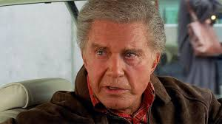
With great power comes great responsibility
Notes:
AI is getting increasingly powerful and in a nonlinear style. With great power, comes great responsibility. So what are some of these.
Ask students what they think are some critical resopnsbility/considerations

Slide 13
Stage 1: Catalyst
Aiding human productivity
“Weak” AI: humans need to be in the loop
Notes:
Right now, AI cannot truly “think” with humans, and instead are more focused on menial retrieval and structural generation tasks, as we’ll see later on in this lecture.
Explanation of present-day AI as "weak" AI, requiring human-in-the-loop feedback, prompt engineering, and other interventions.

Slide 14
(Some) critical considerations
Notes:
I would like to talk about a few of them?

Slide 15
Real vs. AI-generated

Slide 16
That’s what we need to be aware of.
- generated content vs. real ones
- hallucination & malicious actors

Slide 17
Societal impact, e.g., misinformation on social media?

Slide 18
Data Security & Privacy

Slide 19
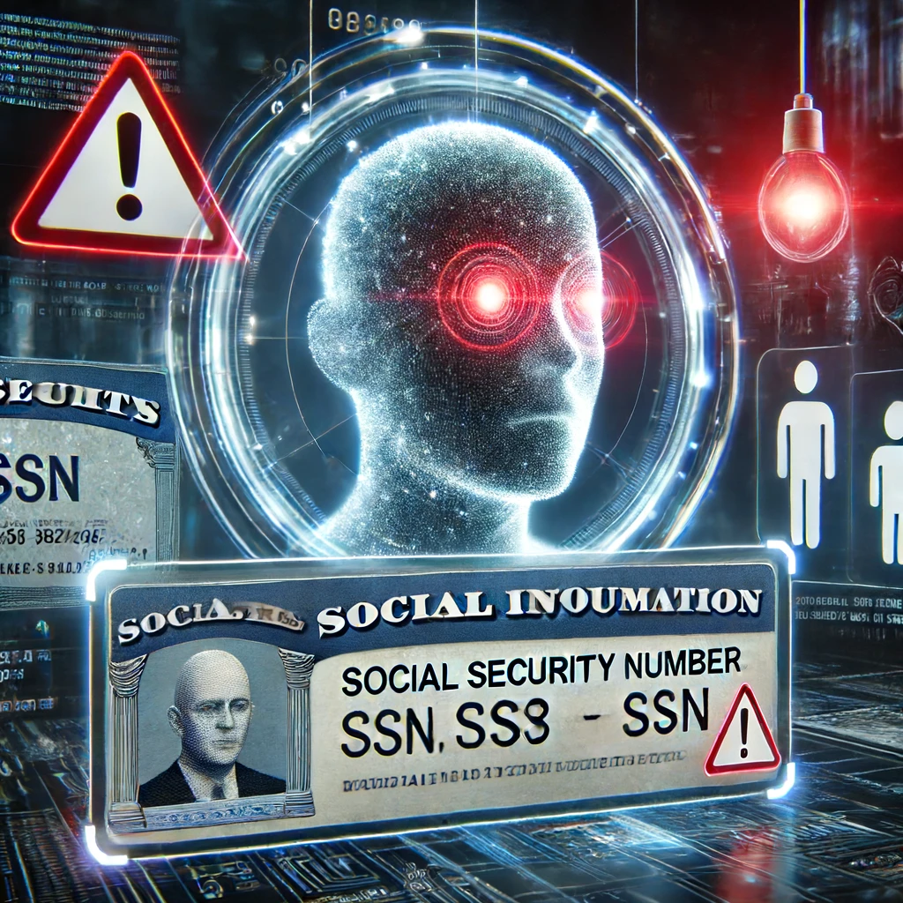
Notes:
BTW, this is generated by chatGPT4o with the prompt “generate an image of an AI model spelling out personal information such as SSN”
This is why we have probably all received emails from UCDavis, saying “we cannot put sensitive information to ChatGPT models”

Slide 20
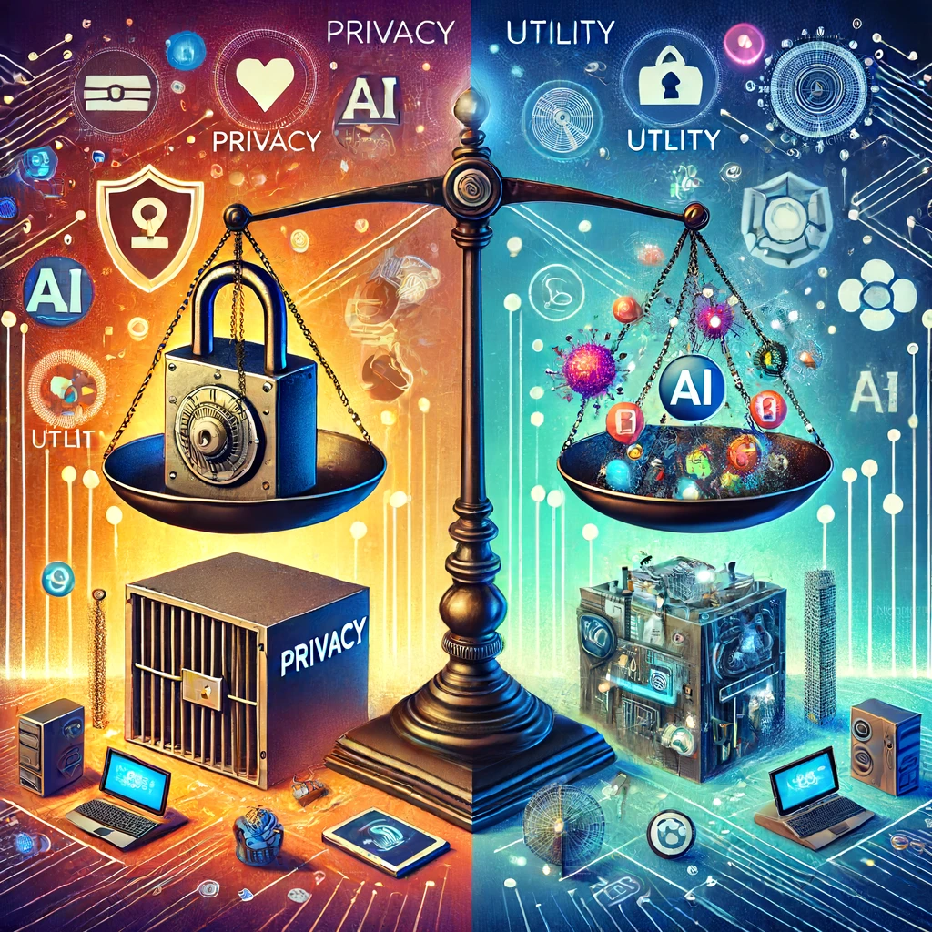
Notes:
Use video survillence as an example. This is an area where AI can be very powerful. Singapore has ~10x survillence cameras/area compared to SF. At the same time, I feel I can walk at midnight in Singapore, but I do not want to even drive to SF during the day time.

Slide 21
Data Bias

Slide 22
"Artificial intelligence is just like people…[its] environment (i.e. training and data) can have quite a big impact on [its performance]."
- Paul Brous, Delft University of Technology, the Netherlands

Slide 23
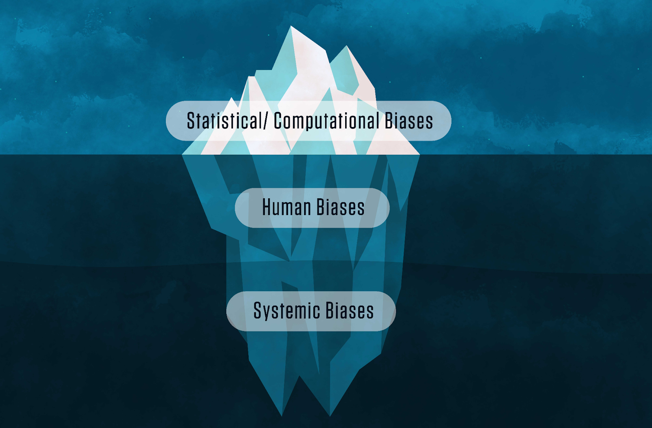
Different biases in AI models
1. Defective models
2. Biased datasets
3. Societal prejudices

Slide 24
AI Safety and Alignment

Slide 25
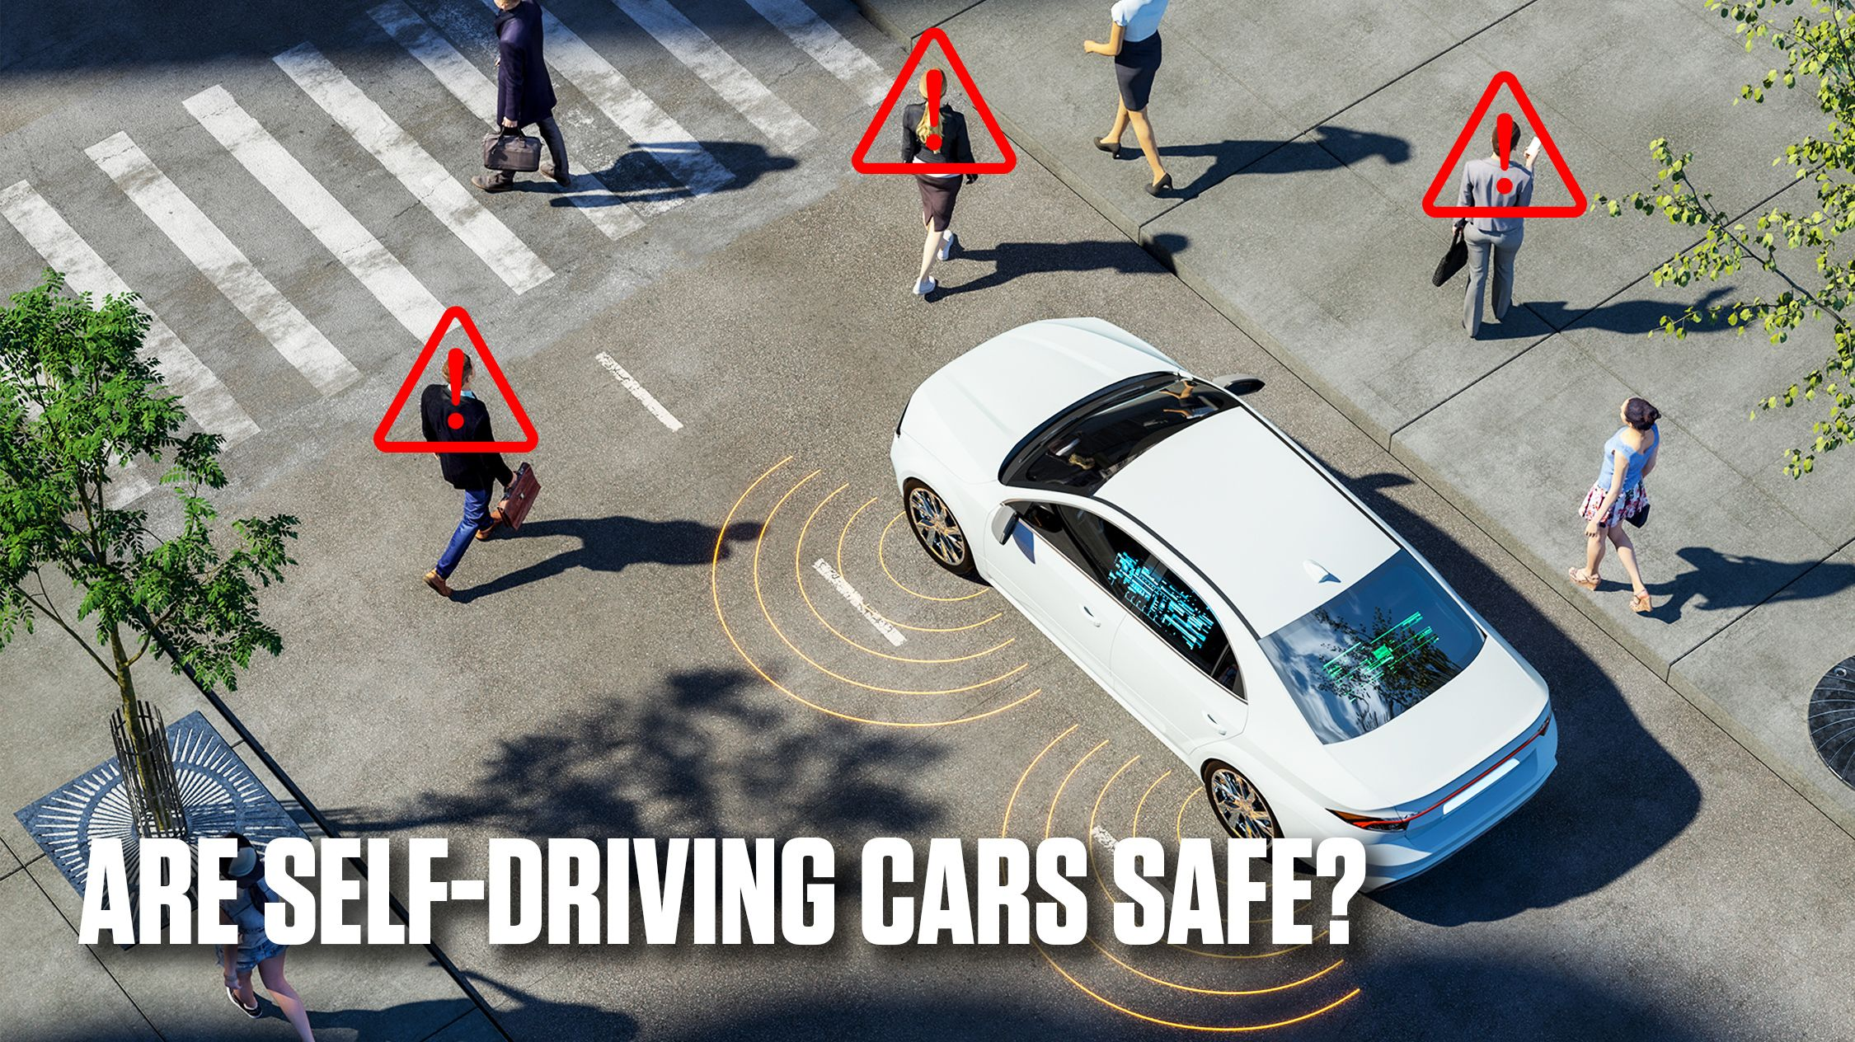
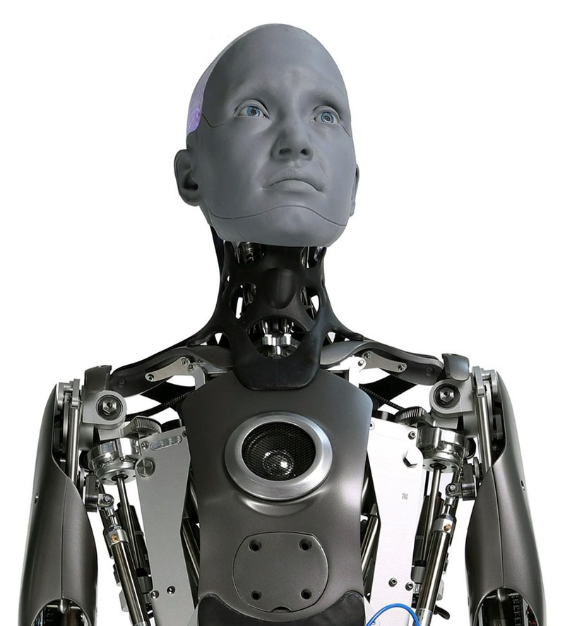
Data Bias

Slide 26
Job displacement and upskilling

Slide 27
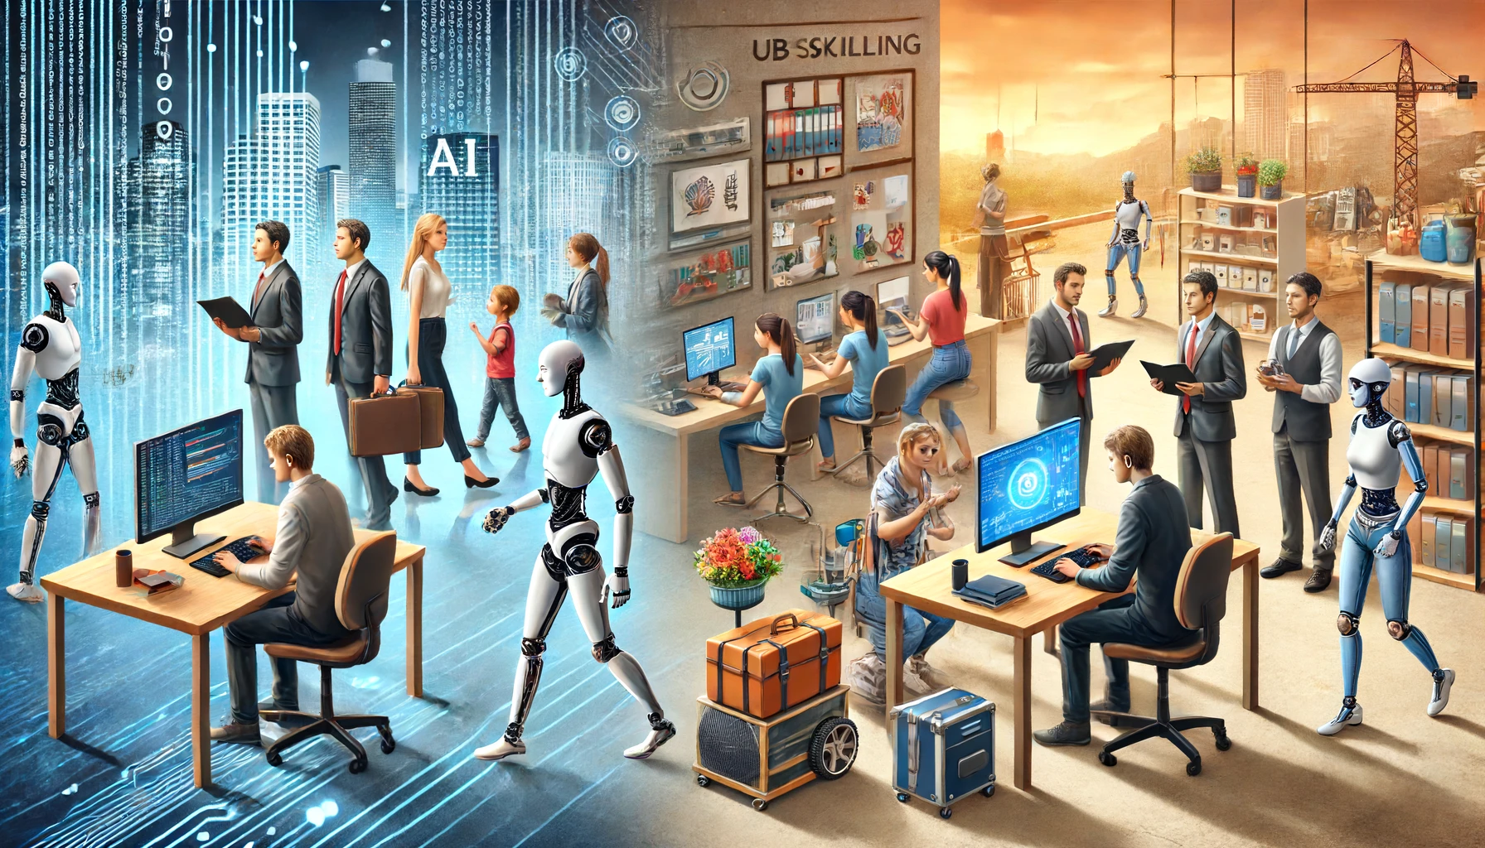

Slide 28
AI Education and Democratization
Notes:
This is where I really want to say a big thank you to my Tas, names here. This bootcamp would not happen without their dedication and devotion.

Slide 29
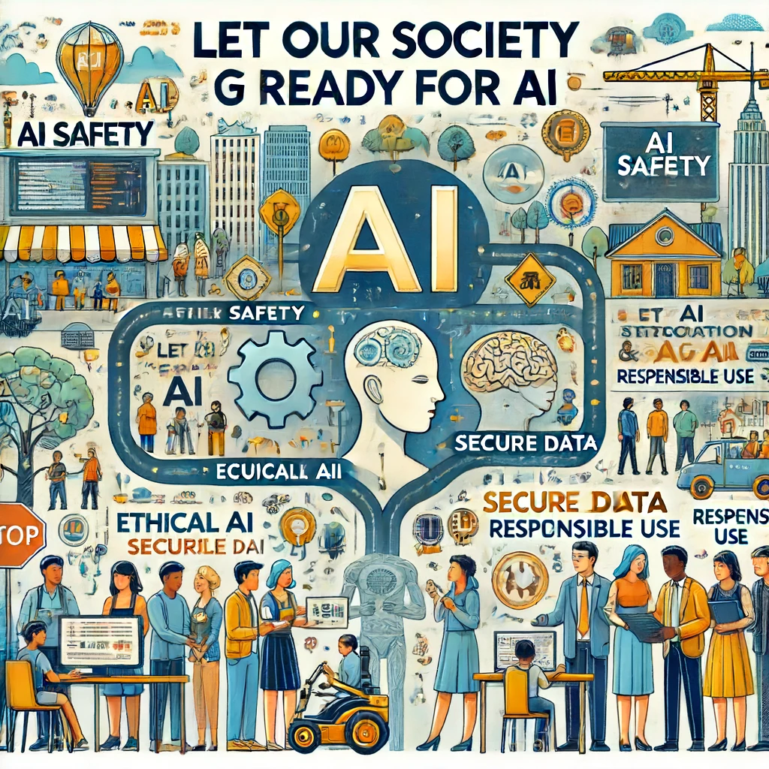
Get Ready for AI

